Slide 1
Information System
ITEC-522
First Semester Third Year
Information Technology
Dr. Khalil-ur-Rahmen Khoumbati
Professor
Department of Information Technology
Faculty of Engineering and Technology
University of Sindh, Jamshoro
Khalil.khoumbati@gmail.com
Week #3

Slide 2

Information Systems in the Enterprise
Chapter 2

Slide 3
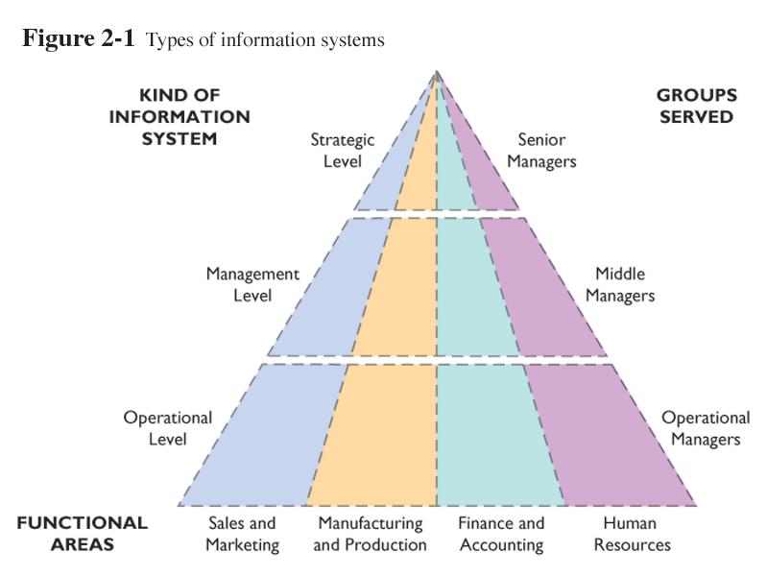
Major Types of Systems in Organizations
Types of information systems

Slide 4
Major Types of Systems in Organizations
Different Kinds of Systems
Three Main Categories of
Information Systems
Operational-level systems
Management-level systems
Strategic-level systems

Slide 5
Major Types of Systems in Organizations
Four Major Types of Systems
Transaction Processing Systems (TPS)
Management Information Systems (MIS)
Decision-Support Systems (DSS)
Executive-Support Systems (ESS)

Slide 6
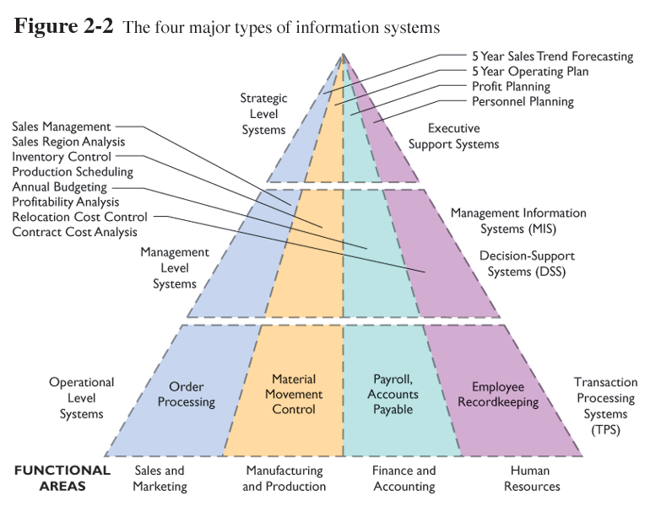
Major Types of Systems in Organizations
The four major types of information systems

Slide 7
Major Types of Systems in Organizations
Four Major Types of Systems
Transaction Processing Systems (TPS)
Basic business systems that serve the organization’s operational level
Input: Transactions, events
Processing: Sorting, listing, merging, updating
Output: Detailed reports, lists, summaries
Users: Operations personnel, supervisors

Slide 8
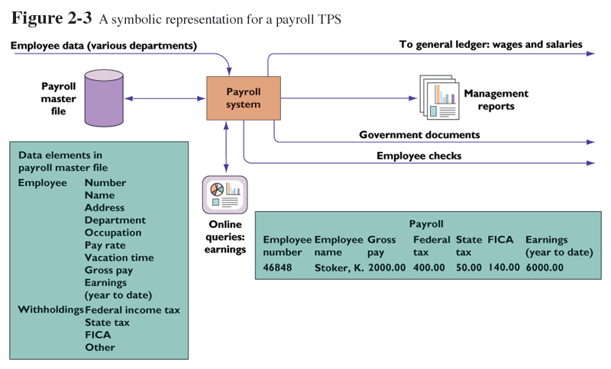
Major Types of Systems in Organizations
A symbolic representation for a payroll TPS

Slide 9
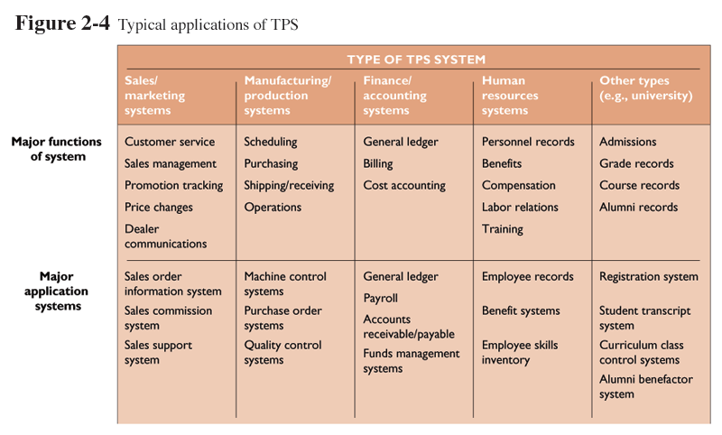
Major Types of Systems in Organizations
Typical applications of TPS
Figure 2-4

Slide 10
Major Types of Systems in Organizations
Four Major Types of Systems
Management Information Systems (MIS)
Serve management level; provide reports and access to company data
Input: Summary transaction data, high-volume data, simple models
Processing: Routine reports, simple models, low-level analysis
Output: Summary and exception reports
Users: Middle managers

Slide 11
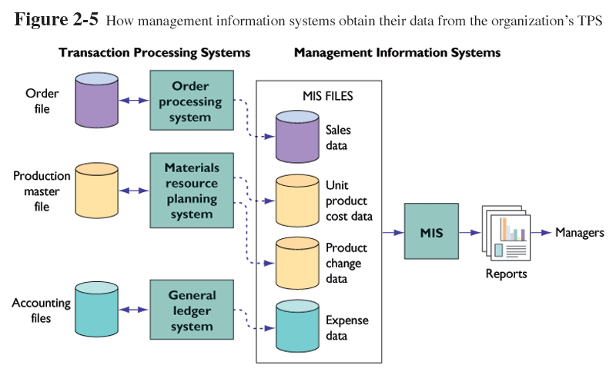
Major Types of Systems in Organizations
How management information systems obtain their data
from the organization’s TPS

Slide 12
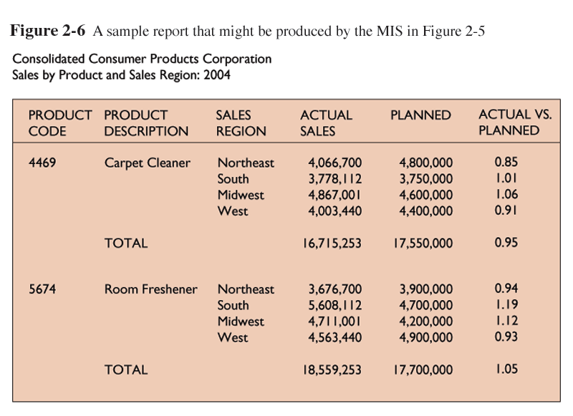
Major Types of Systems in Organizations
A sample report that might be produced by the MIS in Figure 2-5

Slide 13
Major Types of Systems in Organizations
Four Major Types of Systems
Decision-Support Systems (DSS)
Serve management level with data analysis for making decisions
Input: Low-volume data or massive databases, analytic models, and data analysis tools
Processing: Interactive, simulations, analysis
Output: Special reports, decision analyses, responses to queries
Users: Professionals, staff managers

Slide 14
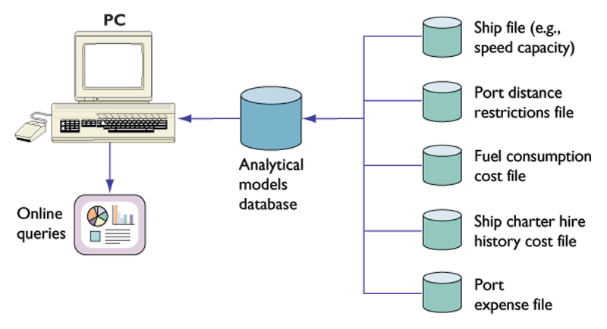
Major Types of Systems in Organizations
Voyage-estimating decision-support system

Slide 15
Major Types of Systems in Organizations
Four Major Types of Systems
Executive Support Systems (ESS)
Provide communications and computing environment that serves the organization’s strategic level
Input: External and internal aggregate data
Processing: Graphics, simulations, interactive
Output: Projections, responses to queries
Users: Senior Managers

Slide 16
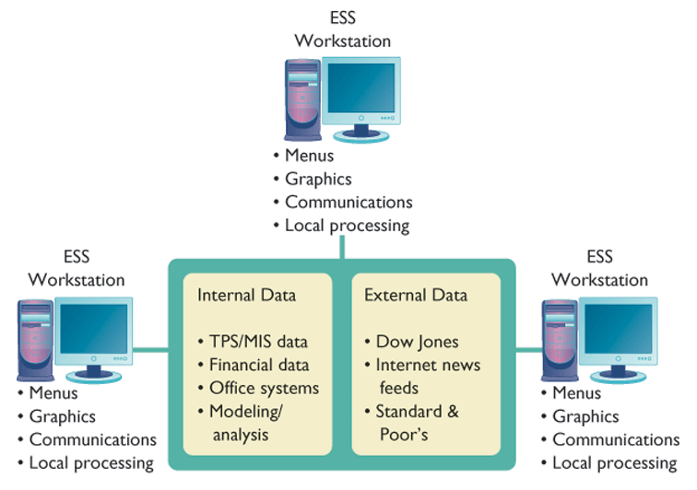
Major Types of Systems in Organizations
Model of a typical executive support system

Slide 17
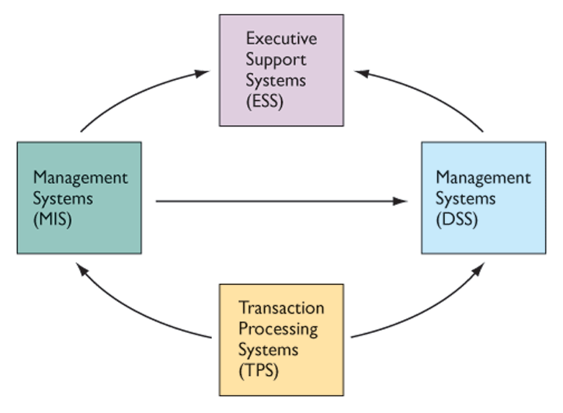
Major Types of Systems in Organizations
Interrelationships among systems
Figure 2-9

Slide 18
Systems from a Functional Perspective
Major Business Functions
Sales and Marketing Systems
Manufacturing and Production Systems
Finance and Accounting Systems
Human Resource Systems

Slide 19
Systems from a Functional Perspective
Sales and Marketing Systems
Help identify customers
Develop products and services
Promote products and services
Sell products and services
Provide ongoing customer support

Slide 20
Systems from a Functional Perspective
Examples of Sales and Marketing Information Systems
System | Description | Organizational Level
Order processing | Enter, process, and track orders | Operational
Pricing analysis | Determine prices for products and services | Management
Sales trend forecasting | Prepare 5-year sales forecasts | Strategic

Slide 21
Systems from a Functional Perspective
Manufacturing and Production Systems
Planning, development, production of products and services
Planning, development, maintenance of production facilities
Acquisition, storage, availability of materials
Scheduling materials, facilities, labor
Controlling the flow of production

Slide 22
Systems from a Functional Perspective
Examples of Manufacturing and Production Information Systems
System | Description | Organizational Level
Machine control | Control the actions of machines and equipment | Operational
Production planning | Decide when and how many products should be produced | Management
Facilities location | Decide where to locate new facilities | Strategic

Slide 23
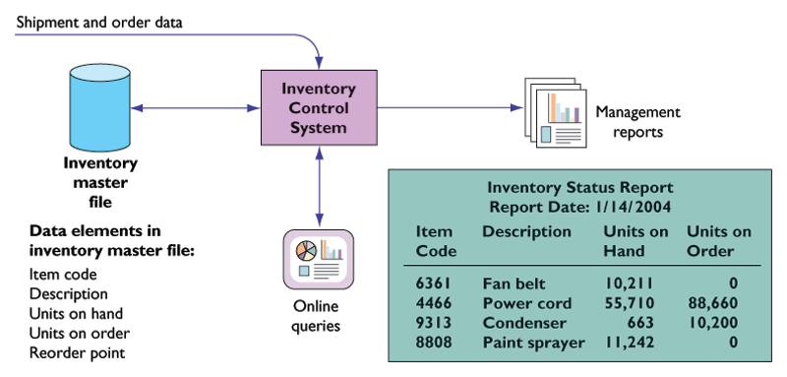
Systems from a Functional Perspective
Overview of an inventory system

Slide 24
Systems from a Functional Perspective
Finance and Accounting Systems
Manage firm’s financial assets: cash, stocks, bonds, etc.
Manage capitalization of firm and finding new financial assets
Maintain and manage financial records

Slide 25
Systems from a Functional Perspective
Examples of Finance and Accounting Information Systems
System | Description | Organizational Level
Accounts receivable | Track money owed the firm | Operational
Budgeting | Prepare short-term budgets | Management
Profit planning | Plan long-term profits | Strategic

Slide 26
Systems from a Functional Perspective
Human Resources Systems
Identify potential employees
Maintain employee records
Track employee skills, job performance, and training
Support planning for employee compensation and career development

Slide 27
Systems from a Functional Perspective
Table 2-5: Examples of Human Resources Information Systems
System | Description | Organizational Level
Training and development | Track employee training, skills, and performance | Operational
Compensation analysis | Monitor wages, salaries, benefits | Management
Human resources planning | Plan long-term labor force needs | Strategic

Slide 28
Systems from a Functional Perspective
Window on Management
Employees Serve Themselves Online
What are the management benefits of employee self-service systems for human resources and benefits administration?
How do these systems provide value for businesses?
What management, organization, and technology issues should be addressed when installing self-service human resources and benefits systems?

Slide 29
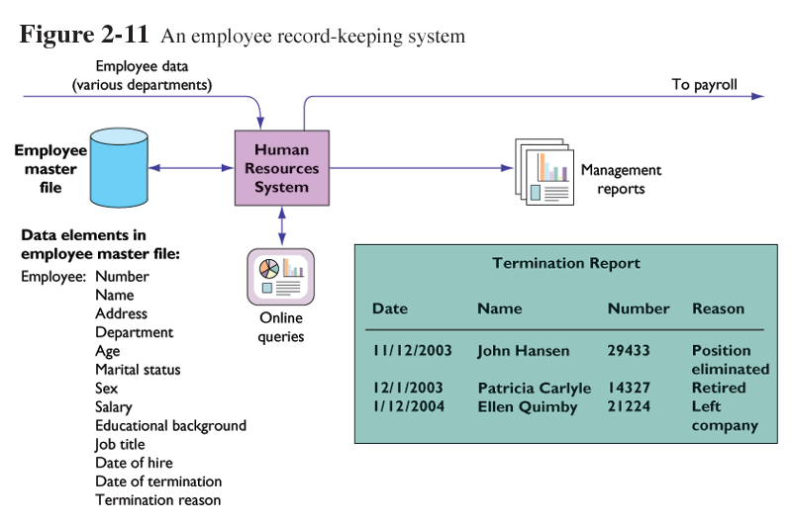
Systems from a Functional Perspective
An employee record-keeping system

Slide 30
Discussion
Questions?

